Slide 1
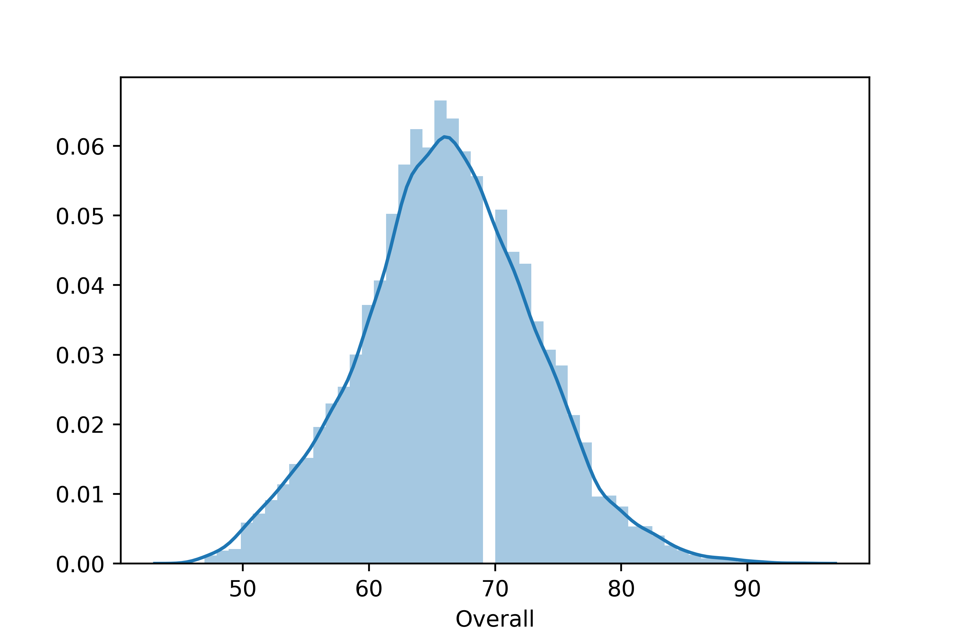
Distribution plot of Overall Rating of the players
From this distribution of Overall Rating (Out of 100), we can say that most of the players have an overall rating between 65 – 75.
The Data appears to be slightly skewed towards right because there are a few players with a rating above 90. Max being 94.
Also if we see towards left we can also see that there are some players with rating in 50s. Minimum being 52.

Slide 2
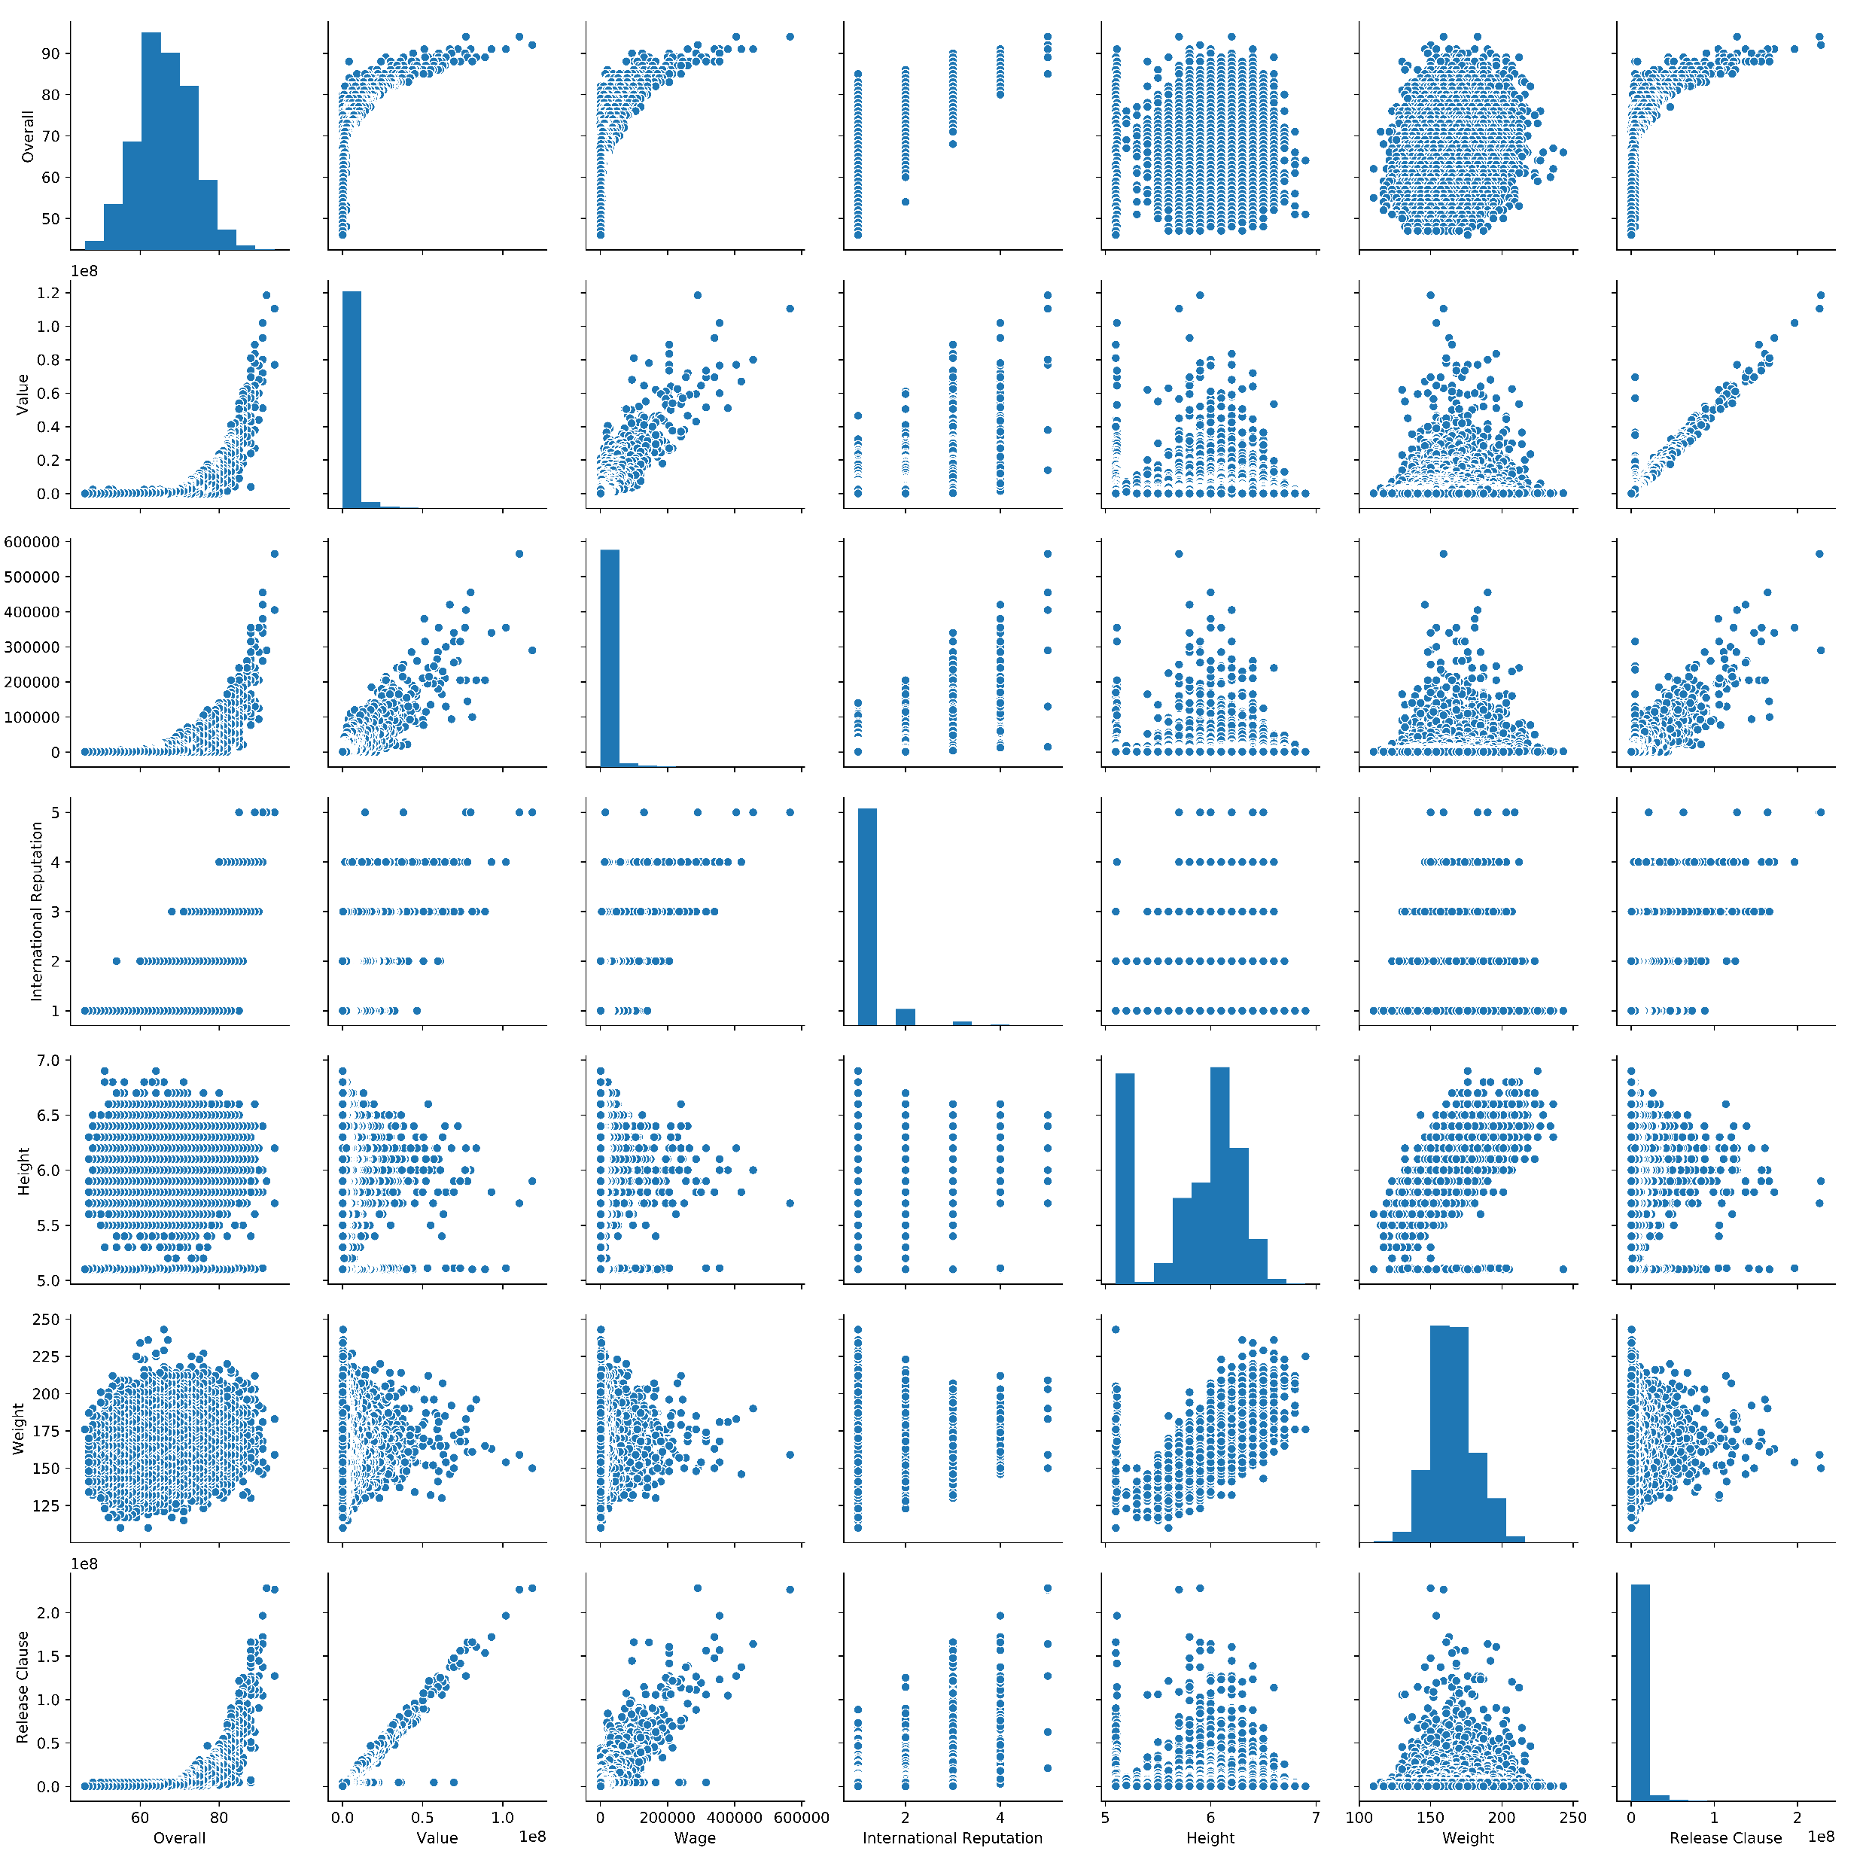
Pair-Plot
Overall
Value
Wage
International Reputation
Height
Weight
Release Clause
Ovrll Rtng | Value | Wage | Int. Rep | Hght | Wght | Rls Cls

Slide 3
Observations based on the pair-plot
There are 241 players who are not associated with any club thereby having their Value, Wage and Release Clause to be 0.
The Value and Wage, both follow same trend with respect to Overall Rating. They increase exponentially with respect to Overall Rating.
Release Clause value increases linearly with the Value of the player.
There are a few players with International Reputation of 5 and the number increases as the Reputation Decreases. Also, as a general trend players having high Reputation has a high Overall Rating.
Height and Weight of players are evenly distributed with respect to Overall Rating.

Slide 4
Observations based on the top 20 players ranked by Overall score whose contract expires in 2020
The Average Age for this set of players is 30.65 years.
The Average Wage for this set of players is € 205.45K.
There is a high correlation between Overall Rating and Value of this set of players viz 0.627

Slide 5
At last we created a Table containing the top 5 players by Overall rating for each unique position
No Player was there who was coming more than once in different positions. Meaning that for each specific position (out of total 27) all the top 5 players are unique.
In other words there are 135 unique players who are among Top 5 players by Overall Rating for each Position.
We also calculated the Average Wage of the top 5 players for each unique Position.

